Slide 1

Web Scraping Project: “Unveiling Insights from Journal Articles ”
Prepared by Merhi El Kallab
In an era where information is abundant, navigating through a vast volume of content can be challenging. Our project aims to streamline this process by leveraging web scraping techniques to extract valuable information from the Radiation Oncology Journal website, using rvest function in R.

Slide 2
Radiation oncology definition:
Radiation oncology is a medical specialty that involves the use of ionizing radiation in the treatment of cancer. The primary goal of radiation oncology is to target and destroy cancer cells while minimizing damage to surrounding healthy tissues.
Radiation therapy, also known as radiotherapy, is a common treatment modality within this field.

Slide 3
Objectives:
Extract the following fields from each article in the journal of year 2022: title, author, publish date, correspondence author, correspondence author email, keywords and abstract.
Display which ‘keywords’ appear most frequently in the articles and visualize the results.
Count the words in ‘abstract’ field and find the top 3 bins proportions with higher wordcounts with its proportion to the whole abstract wordcount and visualize the results.

Slide 4
From coding point of view
I employed the Rvest library for web scraping, extracting 7 fields from the Journal website, including article titles, authors, publication dates, correspondence author and their emails, keywords, and abstracts. The code iterates through multiple pages (5pages), collecting links of individual articles and creating a data frame for each. The aggregated data is then saved in a single data table as a CSV file.
Then, I utilized ggplot2 package for data analysis and visualization, showcasing the top 10 keywords and exploring the distribution of word counts in article abstracts through bar and pie charts.

Slide 5
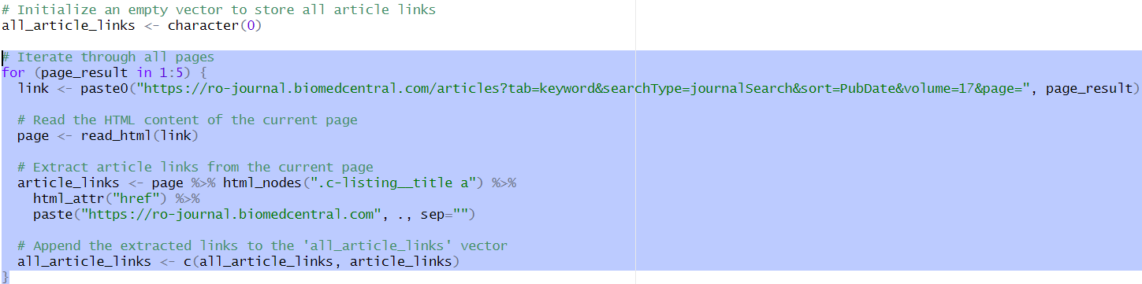
Notes:
First, I wanted to create a vector that contains the article links of all articles published in year 2022, so I can later iterate easier.
I started with creating an empty vector to store all the links, then I used a FOR loop to iterate between the 5 pages using the base url adding each time the page result and extracting them before appending all the links extracted to the vector.

Slide 6
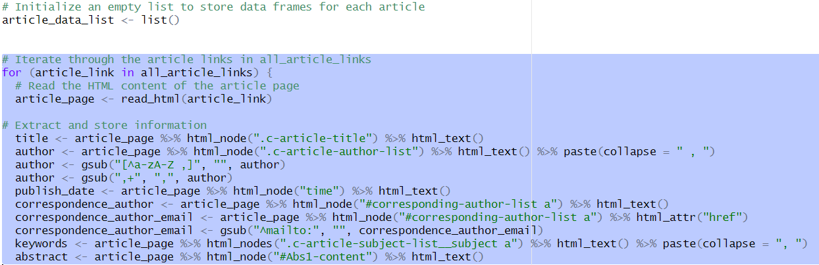
Notes:
In this part of codes, I extracted all the required data by storing data frames for each article in a list and then adding them to a single data frame and used write.csv function to export the file as csv file.
After creating the empty list, I used another FOR loop function to iterate in all article links and extract all the required data. To extract, I used the html_nodes() and defining a CSS selector for each element I want to extract and extracting only the text.

Slide 7
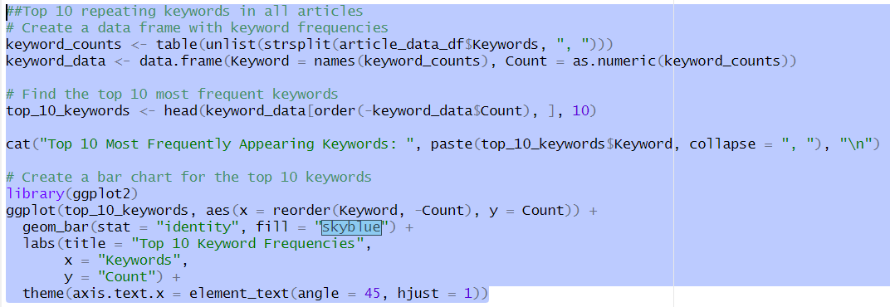
Notes:
In this code, I first beginned by creating a data frame, “keyword_data”, which captures the frequencies of individual keywords by splitting the content of the "Keywords" column. The top 10 most frequent keywords are then identified and stored in the top_10_keywords data frame. Then print the top 10 keywords in a readable format and utilized the ggplot2 library to visualize these top keywords with a bar chart.

Slide 8
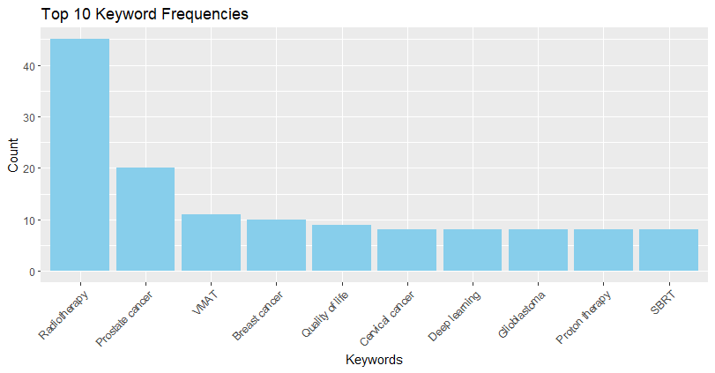
Notes:
The most repeated words in the keyword field were the following, with ‘radiotherapy’ the most occurring one, followed by ‘prostate cancer’ and then ‘vmat’. The least repeated word was ‘serbt’.

Slide 9
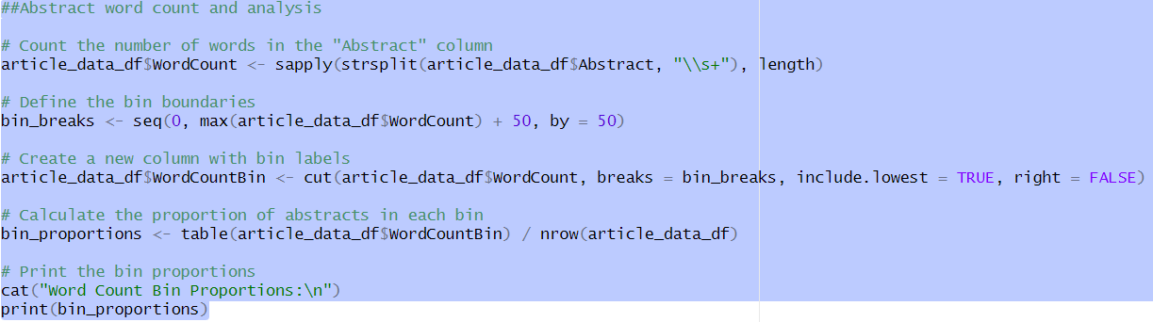
Notes:
I counted the words in abstract field of each article and defined the bin boundaries which determines the counting of words brackets, then I calculated the proportion of abstracts in each bin. I finally visualized the results using a bar plot and a pie chart. Lastly, I calculated the percentage of 3 bins out of total words

Slide 10
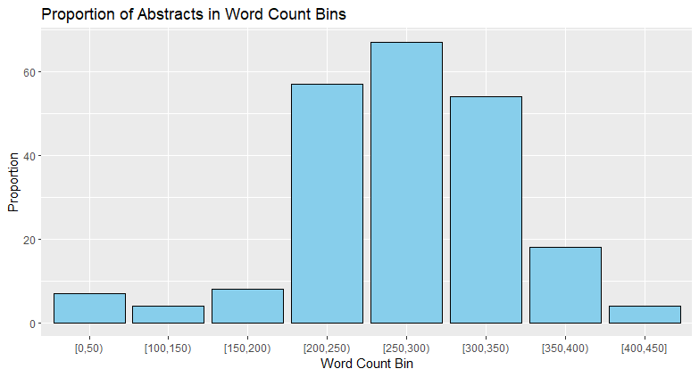

Slide 11
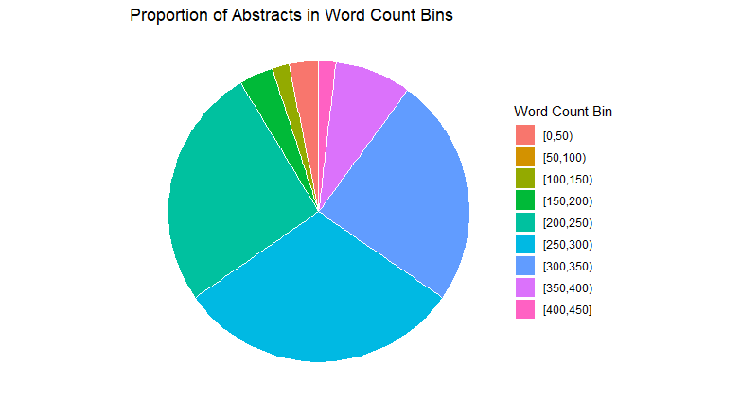
Word Count Proportions for The Top 3 Bins is: 81.28 %

Slide 12
Data cleaning and pre-processing
I started by extracting the data and store them separately in data frames for each article. Then, I combined them in a single data frame and convert it to CSV file.
I used the Gsub function to clean my extracted data from numbers, symbols and empty spaces.
I had no NA values.

Slide 13
The most challenging parts:
Finding the CSS selector in the html page. So, I used the google chrome extension after downloading the selector gadget where directly you can point to the element and CSS selector will be written in a small box where you can copy it and paste it in your function.
Iterating through all pages and extracting the data: I faced so many problems while working on the code, that’s why I decided to create an empty vector and store all the links in it after finding out that the HTML format I am working on follows pagination to iterate between pages.

